Slide 1
ALERT SYSTEM FOR VEHICLES TO AVOID COLLISION DURING MURKY CONDITIONS
Presented by
SUDHAN A – (19351029)
VARUN M – (19351007)
SAHAYA JAMSON S – (19351033)
Guided by Mr. France
(Assistant Professor)

Slide 2
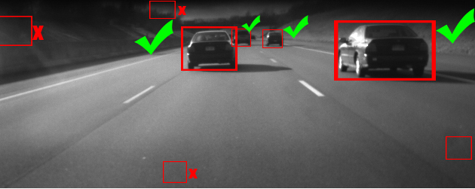
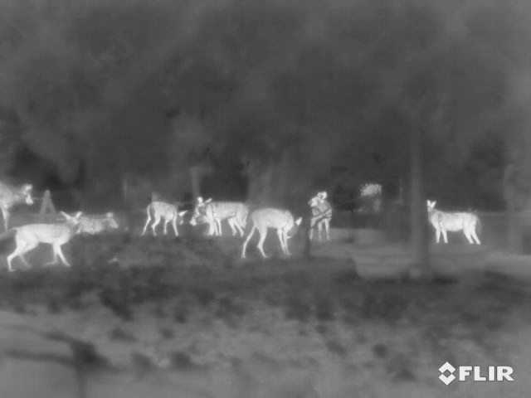
OBJECTIVE :
To enhance the haze (fog) images.
To detect the object from the enhanced image.
To prevent the accident by calculation of distance between detected object and camera mounted vehicle.

Slide 3
INTRODUCTION
Diverse weather situations such as murk, smoke, rain or snow will degrades the visibility during Driving.
Fog/Murk may appreciably humiliate the performances of outdoor vision systems relying on image/video feature extraction or visual attention.
Event detection, Object detection, tracking and recognition, scene analysis and classification of image indexing and retrieval is not possible during Foggy conditions.

Slide 4
They generally fail to correctly detect objects due to low scene visibility. In order to get clear surveillance frames, the obtained images are filtered and enhanced and are free from fog.
From the Enhanced image ,Objects are detected, classified and the distance of the object from the camera mounted vehicle is calculated.
Using the calculated distance to the object, the driver is alerted in case of any possibilities of accidents.

Slide 5
ABSTRACT :
One serious problem that all the developed nations are facing today is death and injuries due to road accidents during Bad Weather conditions.
During Foggy weather conditions, roads are covered with murk(fog) which blocks the view of vehicles in and around which might end up in Collision.
In the proposed system to avoid accidents an camera is mounted to the vehicle, the captured video is segmented into multiple frames in which certain filters are applied to filter out the fog and enhance the details of the object present in the frames to obtain an Murk-Free clear image.
Further the enhanced image is segmented and the objects are detected and classified (Humans, Vehicles and Animals).
Further the distance between the vehicle and the object is calculated based on pixel values. After distance calculation, the values are observed and alerts the driver accordingly to prevent collision.
By using this concept an overall accuracy of almost 90.5% is achieved

Slide 6
LITERATURE SURVEY:
TITLE | AUTHOR | YEAR | REMARKS
Study of single image fog removal techniques in low visibility foggy images | Neha, Rajesh kumar agarwal | 2017 | The problem in this is that recovered image obtained have some halos or block artifacts.
Fast Dark Channel Prior Based Haze Removal from a Single Image | Yutaro Iwamoto, Naoaki Hashimoto, Yen-Wei Chen | 2018 | High computational complexity. Over-enhancement in the sky region. Poor Dehazing
Stereo System based Distance Calculation of an Object in Image | Ningthoujam johny singh, Kishorjit Nongmeikapam | 2019 | The actual distance compared to the measured distance has minute errors

Slide 7
EXISTING SYSTEM:
In existing, they proposed murk/haze removal by using CLAHE and object detection using Curvelet Transform.
Initially the RGB image is converted to gray scale image.
The gray scale image is then filtered using median filter.
The filtered image is enhanced using CLAHE.
Finally the enhanced image is segmented by Curvelet Transform.

Slide 8
PROPOSED SYSTEM:
Step 1: Collecting the test images from public database.
Step 2: Image decomposition is proposed in fog image. In image decomposition, image is decomposed into low frequency part and high frequency part (details layers) based on bilateral filter.
Step 3: After that, dark channel prior based fog removal implement in original fog image; details layers (HF part) enhanced using guided filter for restore the dehazed image with initial fog removed image.
Step 4: The enhanced image is segmented and the object are detected based on saliency map. And also detected object or obstacles are classified based on the statistical feature i.e. Human, Vehicle and Animal.
Step 5: To avoid the accident distance was calculated between the detected object and camera mounted vehicle. Finally based on the distance, some alert system provided to drivers – this can be done with the Hardware setup.

Slide 9
NOVELTY OF THE PROPOSED WORK:
In the existing work the haze/murk removal is done using CLAHE(Contrast Limited Adaptive Histogram Equalization) & object detection using CURVELET TRANSFORM , in which less amount of haze/murk was removed and the detection accuracy was less and distance calculation was not implemented in this work.
The proposed system follows dark channel prior , bilateral filter and an guided filter.
The object is detected using saliency map and finally the distance is calculated and an alert signal is sent to the driver.
In this model we have set alert signal to be switched ON only if the forward obstacle is under 7 meters in distance

Slide 10
BLOCK DIAGRAM :
TEST IMAGE
Image enhancement
Fog Removal Based on
Bilateral & Guided Filter
Dark Channel Prior
Dark Pixels are separated from RGB image
Image Decomposed into LF & HF part
HF part is further removal using guided filter
Object Detection using Saliency Map
Distance calculation
Alert System to driver

Slide 11
RESULTS AND DISCUSSIONS :
The image enhancement has become one of the active areas in the field of image processing.
Thus in this project using the image enhancement and detection we get a better and sharp output image.
Finally distance is calculated between detected object and camera mounted vehicle based on the pixel values of the final output image.
Thus, an efficient automatic vehicle detection and a alert system using image processing can help drivers in reducing the number of accidents during the murky conditions and leads to a safe journey.

Slide 12
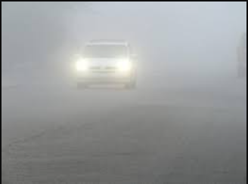
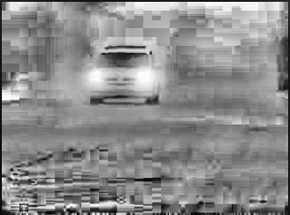
Original Image
Grayscale Image

Slide 13
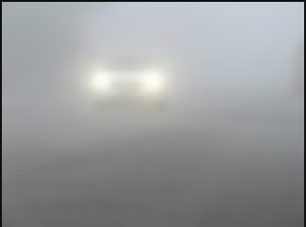
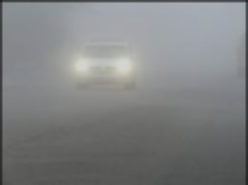
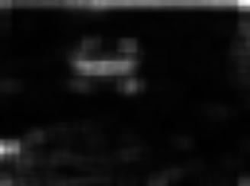
Bilateral Filter
Guided Filter
Saliency
Car
Some Object

Slide 14
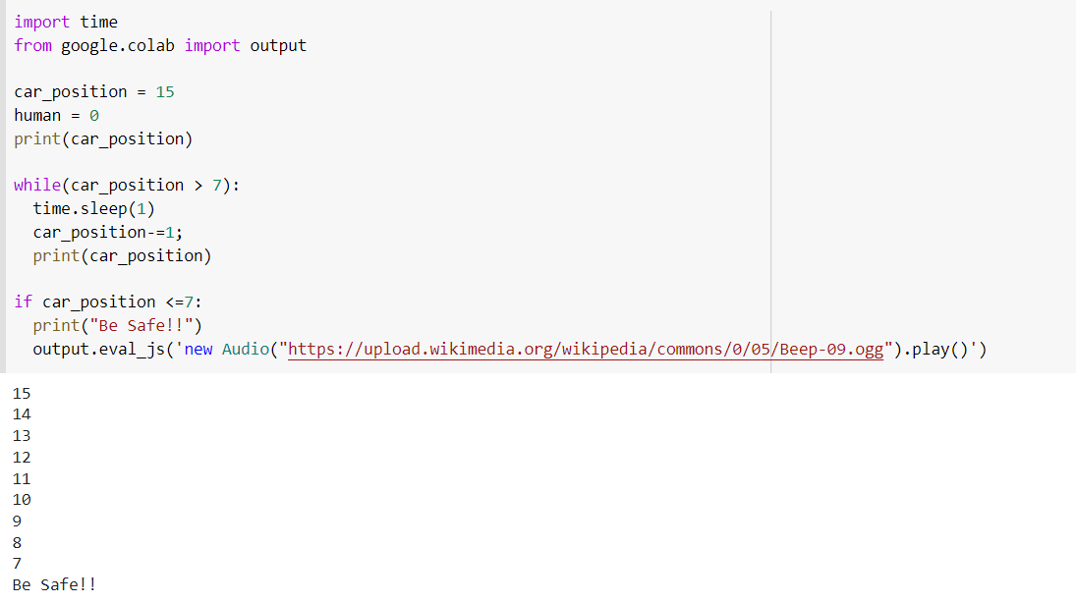
SIMULATION

Slide 15
FUTURE SCOPE :
As a future step, we have to analyze the behavior for images from other categories too.
Furthermore another interesting question is if and how this method would work on night-time scenes .
And as a hardware setup, we have to install our modules in a vehicle and to test it in a real-time scenario and to check out the practical output of our design and to install more cameras to monitor from all sides of the vehicle as the obstacles can reach out and hit our vehicle in any directions.

Slide 16
Advantages:
Disadvantages:
The high level of performance occurs in removal of rain and haze.
The rate of detection accuracy is high.
The distance calculation is implemented to prevent the accident
In existing less amount of haze/murk removal in image is proposed.
The rate of detection accuracy was less.
And distance calculation is not implemented in existing for alert the driver

Slide 17
MODULES USED :
Image Acquisition
Image Enhancement
Obstacle Detection & Classification
Distance Calculation

Slide 18
REFERENCES:
[1] G. He, H.-Y. Qin, and Q. Zheng, “Rayleigh, mie, and tyndall scatterings of polystyrene microspheres in water: Wavelength, size, and angle dependences,” Journal of Applied Physics, vol. 105, no. 2, pp. 023 110– 023 110–10, Jan 2009.
[2] U. Brummund and B. Mesnier, “A comparative study of planar mie and rayleigh scattering for supersonic flowfield diagnostics,” in Instrumentation in Aerospace Simulation Facilities, 1999. ICIASF 99. 18th International Congress on, 1999, pp. 42/1–4210.
[3] H. Koschmider, “Theorie der horizontalen sichtweite,” in Proc. BeitragePhys. Freien Atmos., 1924, pp. 33–53.
[4] S. Narasimhan and S. Nayar, “Chromatic framework for vision in bad weather,” in Computer Vision and Pattern Recognition, 2000. Proceedings. IEEE Conference on, vol. 1, 2000, pp. 598–605.
[5] S. G. Narasimhan and S. K. Nayar, “Vision and the atmosphere,” Int. J. Comput. Vision, vol. 48, no. 3, pp. 233–254, Jul. 2002. [Online]. Available: http://dx.doi.org/10.1023/A:1016328200723

Slide 19
[6] Y.Y. Schechner and N. Karpel, “Recovery of underwater visibility and structure by polarization analysis,” IEEE Journal of Oceanic Engineering, Volume: 30, Issue: 3, pp. 570 – 587, July 2005.
[7] J. Kopf, B. Neubert, B. Chen, M. Cohen, D. Cohen-Or, O. Deussen, M. Uyttendaele, and D. Lischinski, “Deep photo: Model-based photograph enhancement and viewing,” ACM Trans. Graph., vol. 27, no. 5, pp. 116:1–116:10, Dec. 2008.
[8] K. B. Gibson “An investigation of dehazing effects on image and video coding,” Image Processing, IEEE Transactions on, vol.21 issue.2, pp. 66 –673, Jan 2012.
[9] R. Tan, “Visibility in bad weather from a single image,” in Computer Vision and Pattern Recognition, 2008. CVPR 2008. IEEE Conference on, June 2008, pp. 1–8.
[10] J.-P. Tarel and N. Hauti`ere, “Fast visibility restoration from a single color or gray level image,” in Proceedings of IEEE International Conference on Computer Vision (ICCV’09), Kyoto, Japan, 2009, pp. 2201–2208, http://perso.lcpc.fr/tarel.jean-philippe/publis/iccv09.html.

Slide 20
THANK YOU

